Slide 1
Object Oriented programming using Java Chapter1 – An Introduction to Java
KANIMBA Patrick
hpnkanimba@iprcsouth.ac.rw
Department of Information and Communication Technology
Integrated Polytechnic Regional Center
Huye Campus
http://iprcsouth.ac.rw

Slide 2
Outline
Java’s past, present and future
What is Java
Java’s features
The program types of Java
Development tools
The first Java program
Java vs. other languages
Summary

Slide 3
Java’s Past, Present and Future

Slide 4
Computer Organization
Input unit
Mouse, keyboard
Output unit
Monitor, printer, audio speakers
Memory unit
RAM
Arithmetic and logic unit (ALU)
Performs calculations
Central processing unit (CPU)
Supervises operation of other devices
Secondary memory unit
Hard drives, floppy drives

Slide 5
Programming languages
Machine language
“Natural language” of computer component
Machine dependent
Assembly language
English-like abbreviations represent computer operations
Translator programs convert to machine language
High-level language
“English-like” instructions
Compiler convert to machine language

Slide 6
Some representative languages
Structural programming language
FORTRAN (IBM Mathematical FORmula TRANslation)
BASIC (Beginner‘s All Purpose Symbolic Instruction Code)
COBOL (Common Business Oriented Language)
PASCAL
C
Object-Oriented programming language
C# (C Sharp): Microsoft
C++
Object Pascal
Java
SmallTalk
Ada

Slide 7

Who develops Java?
The Java language was developed at Sun Microsystems in 1991 as part of a research project to develop software for consumer electronics devices.

Slide 8

Java’s creator
Java is a programming language and enviroment whose original name was Oak and developed as a part of the Green project at Sun started by James Gosling.

Slide 9
Java’s initial goal
Java’s goals at that time were to be small, fast, efficient, and easily portable to a wide range of hardware devices.
It is those same goals that made Java an ideal language for distributing executable programs via the World Wide Web.
“Write once, run anywhere!”

Slide 10
Java’s future
Enterprise information system
Mobile application
Distributed computing
Web services
Grid

Slide 11
Brief summary
Computer organization
Programming language
Java’s developer
Java’s creator
Java’s initial goal

Slide 12
What is Java

Slide 13
A graceful O-O language
Java is an object-oriented programming language developed by Sun Microsystems

Slide 14
Small, simple and portable
Java was designed to be small, simple, and portable across platforms and operating systems
at the source level
at the binary level

Slide 15
Full-fledged language
Java was written as a full-fledged programming language in which you can accomplish the same sorts of tasks and solve the same sorts of problems that you can in other programming languages, such as C or C++.
simpler than C++
similar with C or C++

Slide 16
Brief summary
Java is a graceful O-O language
Java is small, simple and portable
Java is a full-fledged language

Slide 17
Java’s Features

Slide 18
Simple
Memory management is automatic
No pointers
Small core

Slide 19
Object-Oriented
Inheritance
Polymorphism
Overload

Slide 20
Distributed
RMI
CORBA
Web Services

Slide 21
Robust
Garbage collectors
Exception handling
Warning

Slide 22
Secure
No pointers
Sandbox

Slide 23
Architecture-neutral
Byte code
OS independent

Slide 24
Portable
Portable Java program
Portable Java system

Slide 25
Interpreted
Compiler
Interpreter

Slide 26
High performance
Byte code includes compiling information
Interpreter interprets byte code quickly

Slide 27
Multithread
Parallel task
Data sharing

Slide 28
Dynamic
Extended class lib
Multiple inheritance based on Interface

Slide 29
Brief summary
11 features of Java
Dynamic, Multithread, High performance, Interpreted, Portable, Architecture-neutral, Secure, Robust, Distributed, O-O, Simple

Slide 30
Why Learn Java?

Slide 31
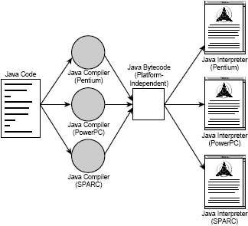
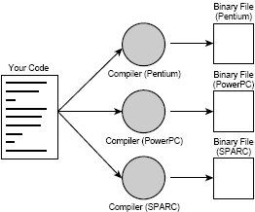
Platform-independent

Slide 32
Object-Oriented
Take full advantage of O-O methodlogy
Create flexible, modular and reusable code
Includes powerful class libraries written in Java

Slide 33
Easy to learn
Java is more powerful than C
Java is easier than C++
One of Java’s goal is small and simple
Easy to write, easy to compile, easy to debug
Easy to learn

Slide 34
Brief summary
Platform-independent
Object-Oriented
Easy to learn

Slide 35
The Types of Java Programs

Slide 36
Java Application
Run on local computer
Based on J2SE (SE: Standard Edition)

Slide 37
Java Applet
Run on web browser

Slide 38
Java Servlet
Run on application server

Slide 39
JavaBeans
Cannot run independently

Slide 40
Enterprise JavaBeans
Run on application server
Based on J2EE

Slide 41
Development Tools

Slide 42
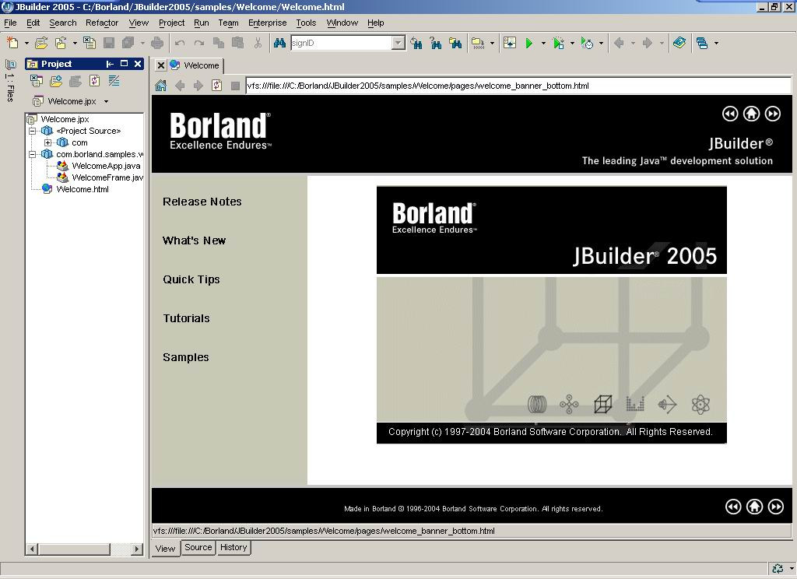
JBuilder

Slide 43
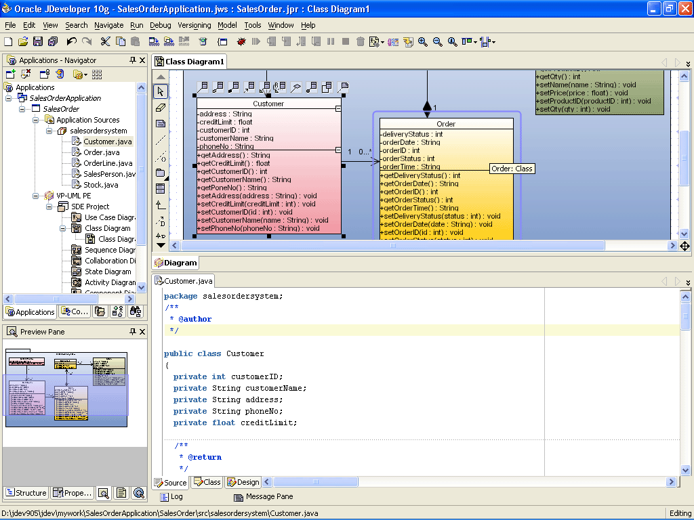
JDeveloper

Slide 44
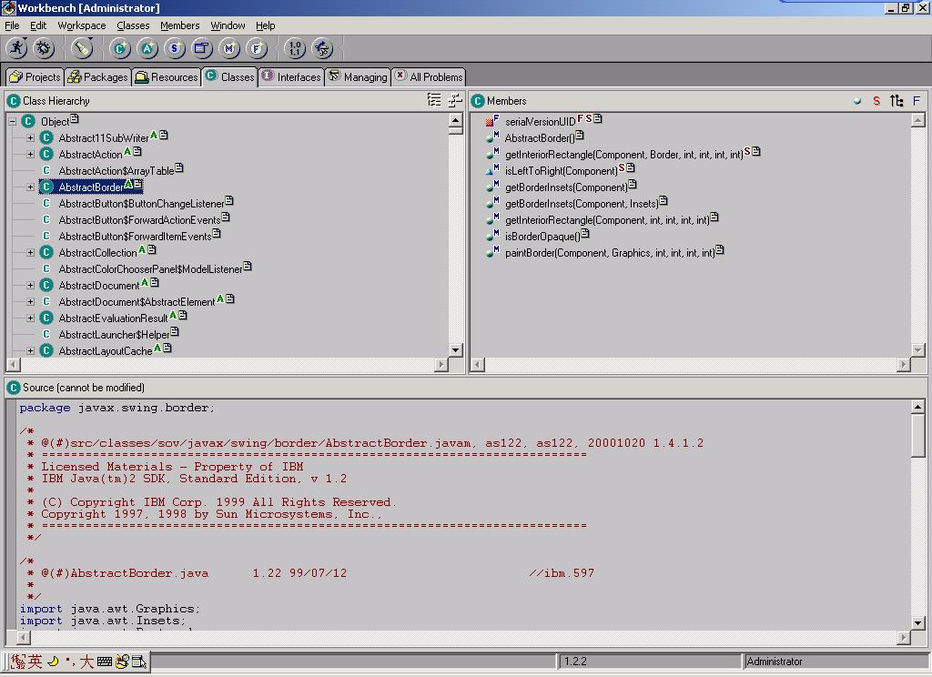
Visual Age for Java

Slide 45
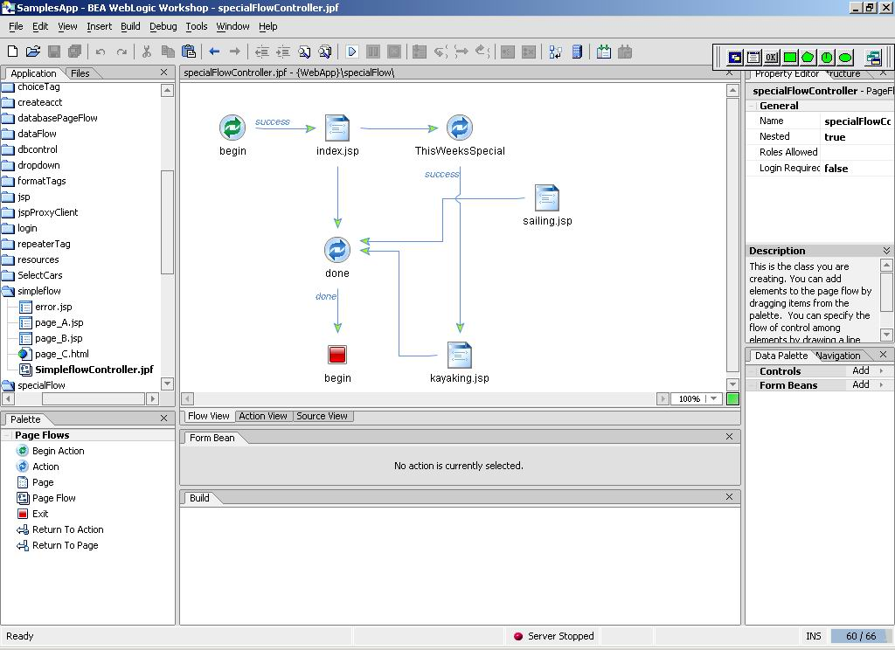
BEA WebLogic Workshop

Slide 46
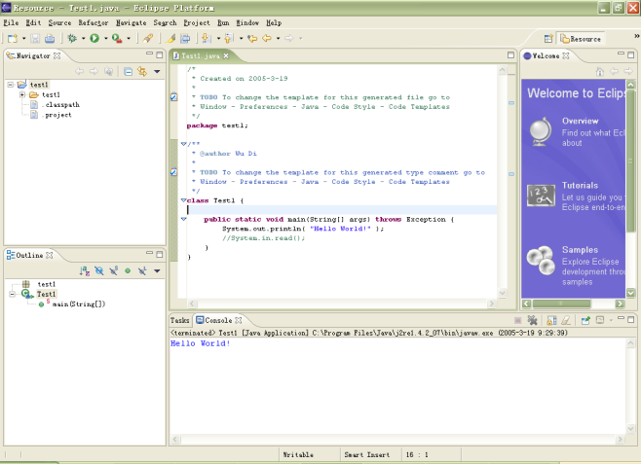
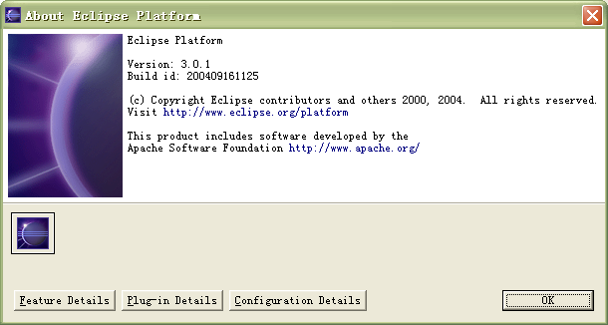
Eclipse
Eclipse Platform
http://www.eclipse.org/platform
Developed by the Apache Software Foundation

Slide 47
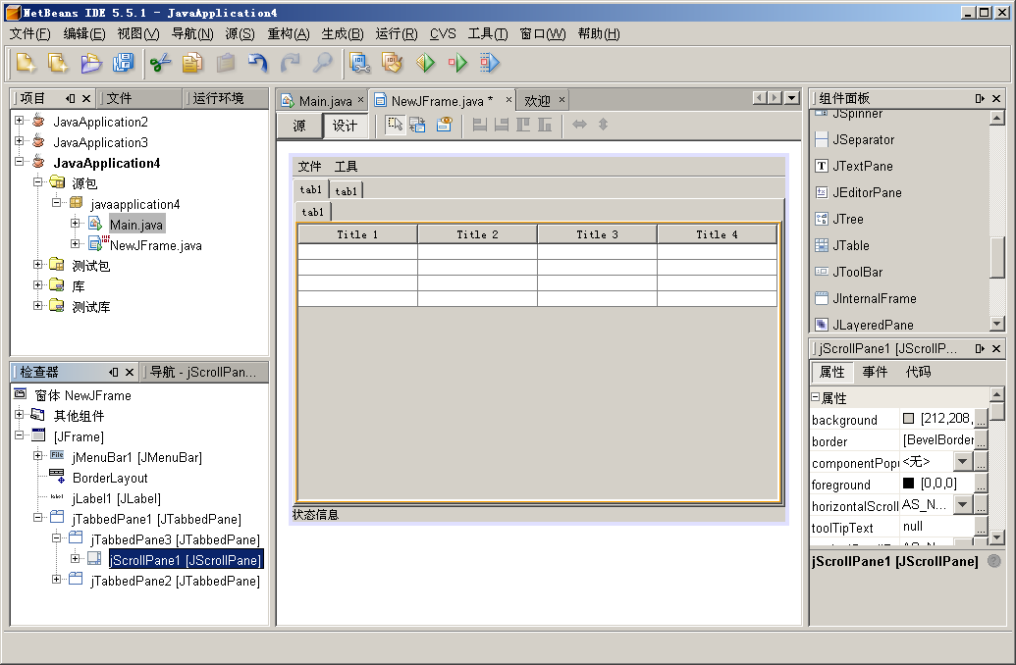
Netbeans

Slide 48
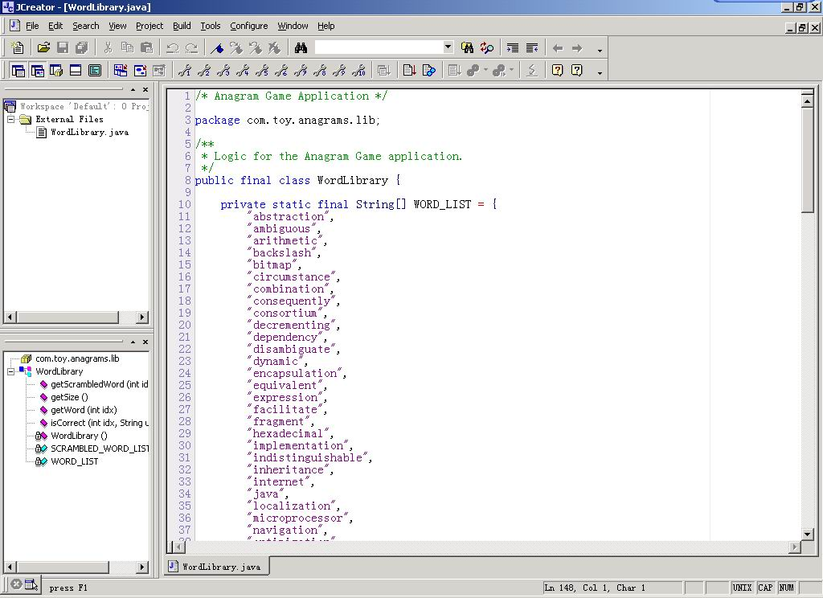
JCreator

Slide 49
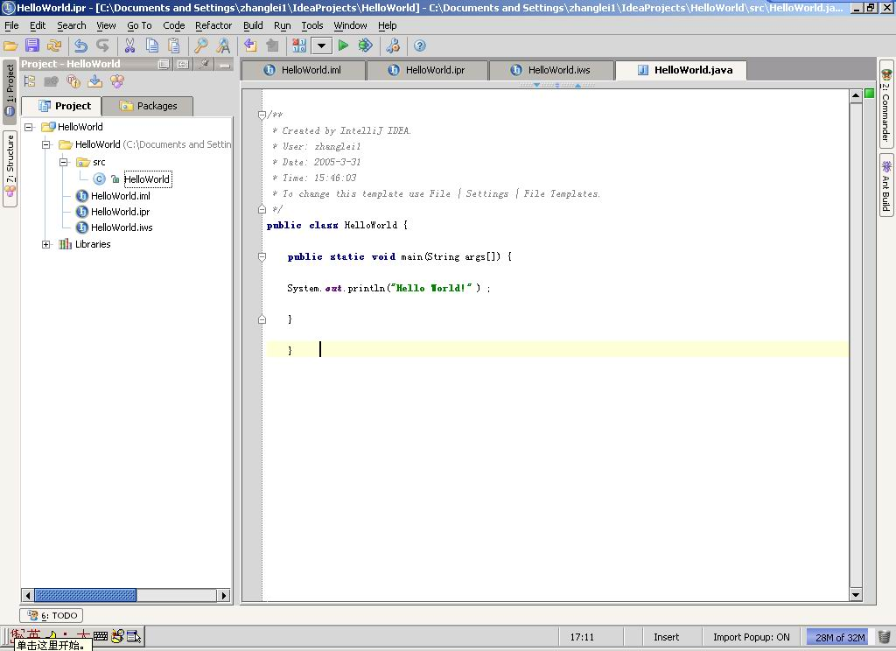
IntelliJ

Slide 50
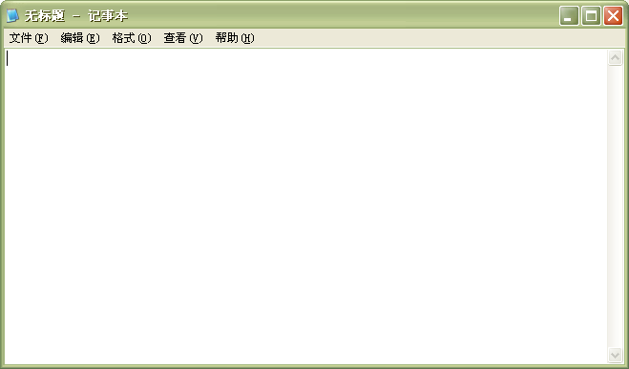
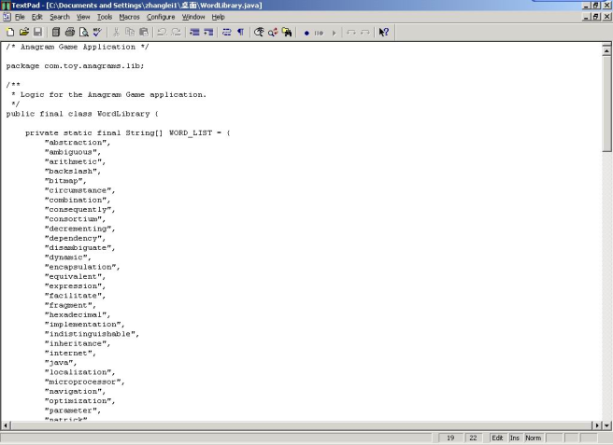
Textpad & Notepad
The simplest tool: JDK + text editor

Slide 51
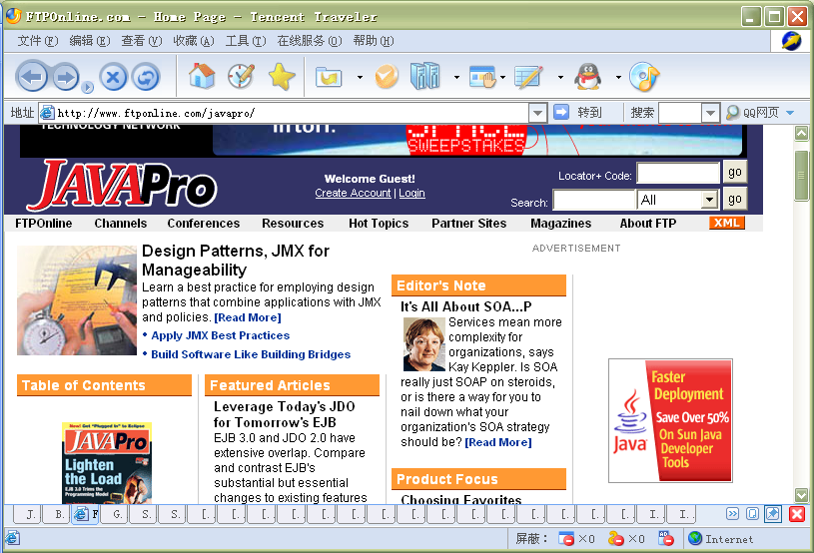
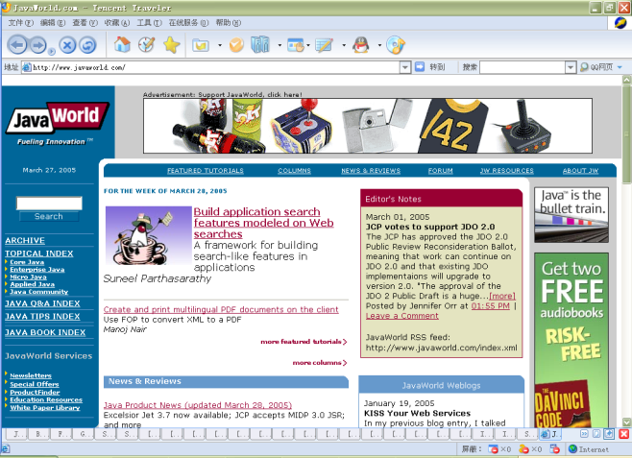
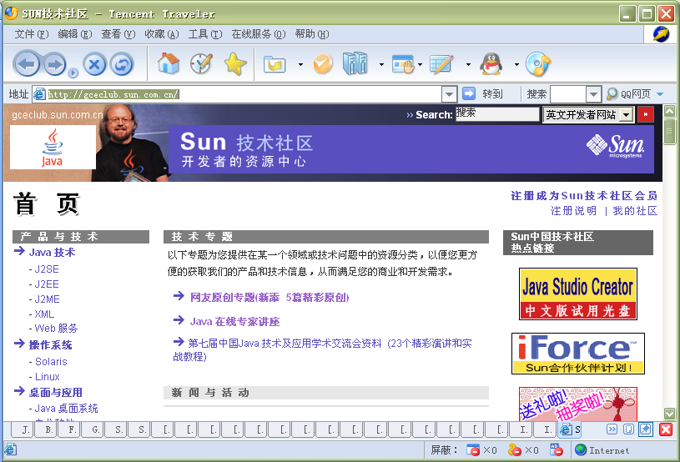
Java communities
http://www.javaworld.com
http://www.javapro.com
http://gceclub.sun.com.cn/

Slide 52
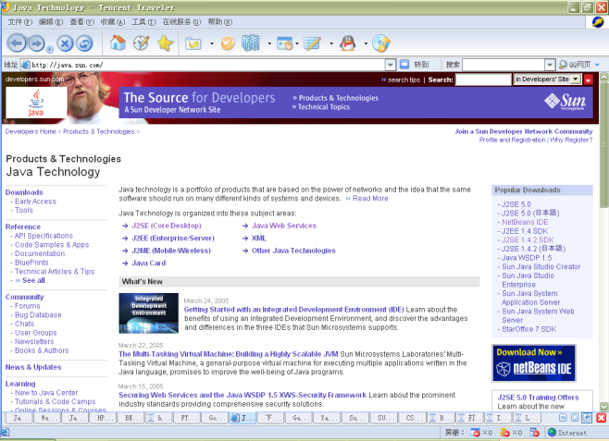
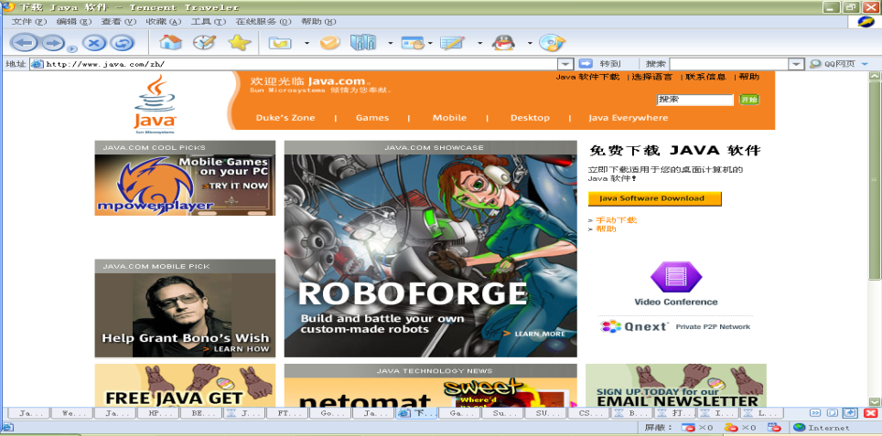
Java Home
http://java.sun.com
http://www.java.com

Slide 53
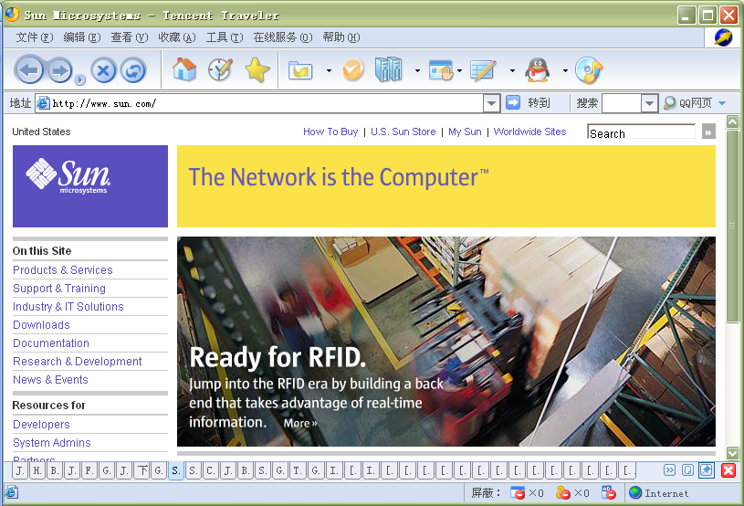
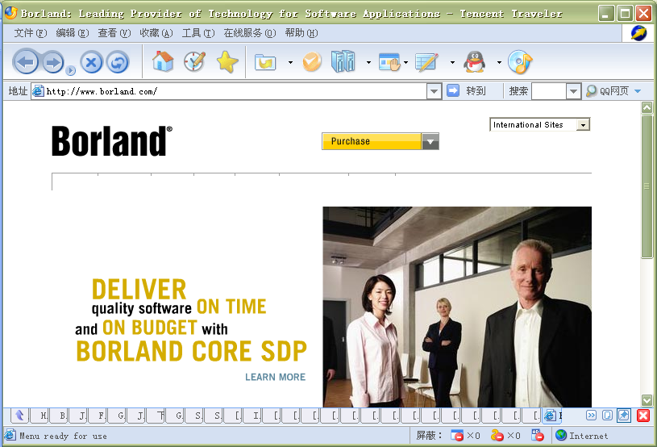
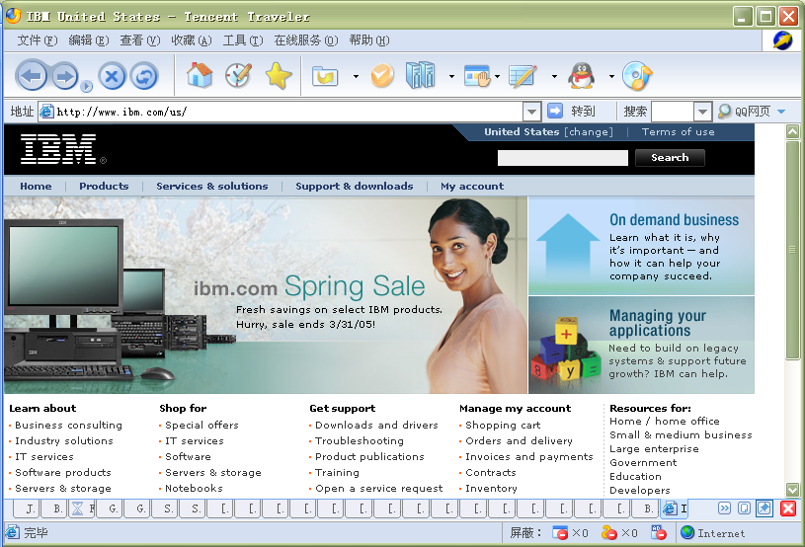
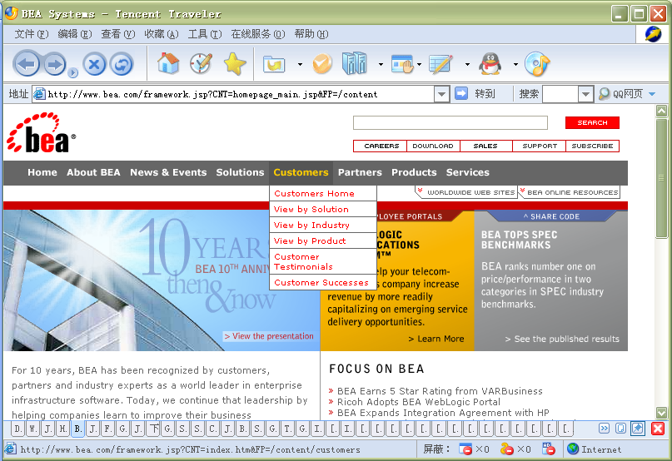
Java supported companies

Slide 54
Target version and tools
Target JDK version of this class
J2SDK 6.0
Recommended development tools
Netbeans 5.5 - provided by SUN
Eclipse Platform 3.1 - provided by Apache

Slide 55
How to get the software?
http://java.sun.com
http://www.eclipse.org

Slide 56
Brief Summary
Development tools
Target version
Recommended tools
Where can we get it

Slide 57
The First Java Program

Slide 58
Hello World!
HelloWorld.java
package lesson1; /** * @patty * * The first Java program of Java Class */ public class HelloWorld { public static void main(String[] args) { System.out.println( "Hello World!" ); }//main() }/* HelloWorld */

Slide 59
File
HelloWorld.java
not helloworld.java, helloWorld.java…

Slide 60
Package
“package lesson1;”
package
package name = directory name

Slide 61
Class
“public class HelloWorld { … }”
public
class
bracket
public class name = file name
One .java file can includes more than one class, but only one public class can be defined in it.

Slide 62
Comment
/** * @authorPatty * * The first Java program of Java Class */
//main()
}/* HelloWorld */

Slide 63
Method
“public static void main( String[] args ) {…}”
public
static
void
String[] args
bracket

Slide 64
Print screen
“System.out.println( … );”
print
println

Slide 65
String
“Hello World!”

Slide 66
Java environment
Java systems contain:
Environment
Language
APIs
Class libraries

Slide 67
How “hello world” runs?
Edit
Programmer writes program (and stores program on disk)
Compile
Compiler creates bytecodes from program
Load
Class loader stores bytecodes in memory
Verify
Verifier ensures bytecodes do not violate security requirements
Execute
Interpreter translates bytecodes into machine language

Slide 68
Phase 1: edit
Programs is created in an editor and stored on disk

Slide 69
Phase 2: Compile
Compiler creates byte codes and stores them on disk

Slide 70
Phase 3: Load
Class loader puts byte codes in memory

Slide 71
Phase 4: Verify
Byte code verifier confirms that all byte codes are valid and do not violate Java’s security restrictions

Slide 72
Phase 5: Execute
Interpreter reads byte codes and translates them into a language that the computer can understand, possibly storing data values as the program executes

Slide 73
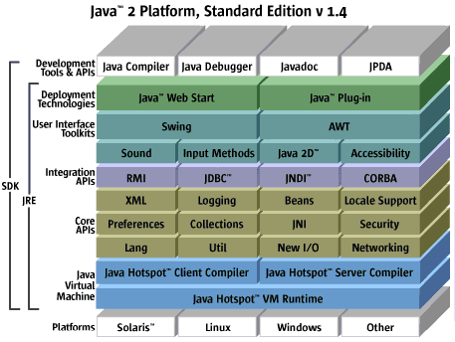
The structure of J2SDK 1.4

Slide 74
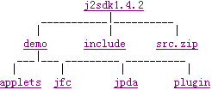
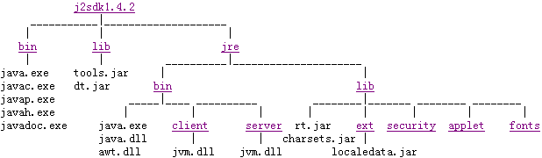
Files and directories
Development files and directories
Additional files and directories

Slide 75
How to run HelloWorld?
Set path
Compile
Run

Slide 76
Set path

Slide 77
Compile
javac HelloWorld.java

Slide 78
Run
java HelloWorld

Slide 79
Basic tools
javac | The compiler for the Java programming language
java | The launcher for Java applications
javadoc | API documentation generator
appletviewer | Run and debug applets without a web browser
jar | Manage Java Archive (JAR) files
jdb | The Java Debugger
javah | C header and stub generator. Used to write native methods.
javap | Class file disassembler
extcheck | Utility to detect Jar conflicts

Slide 80
Run HelloWorld
javac HelloWorld.java
java HelloWorld
Output:
Hello World!

Slide 81
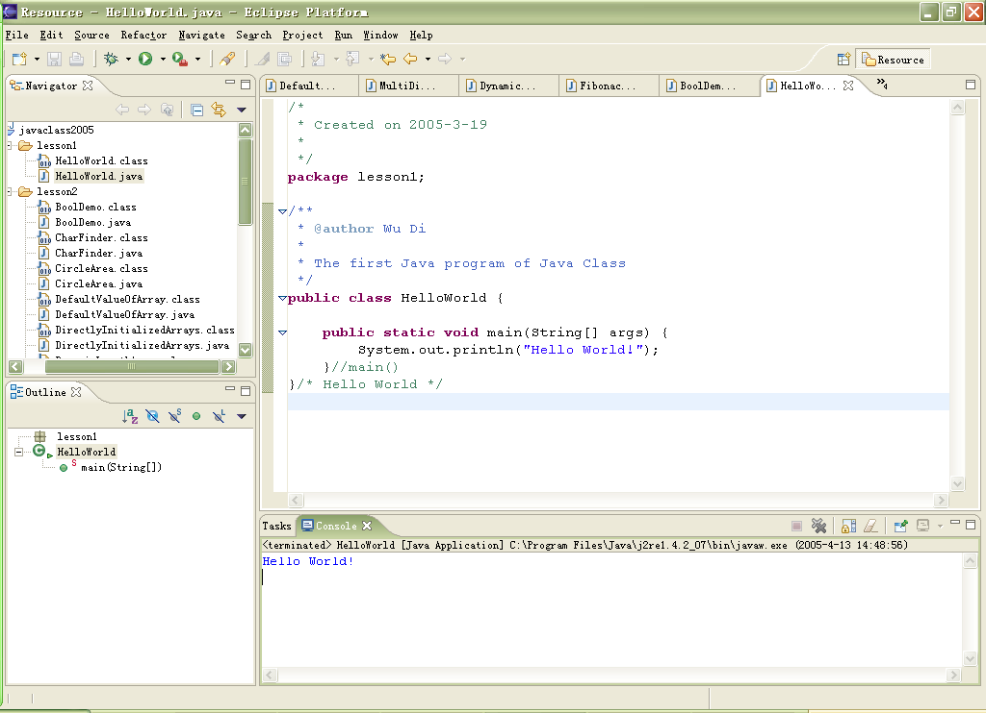
Use Eclipse to run HelloWorld

Slide 82
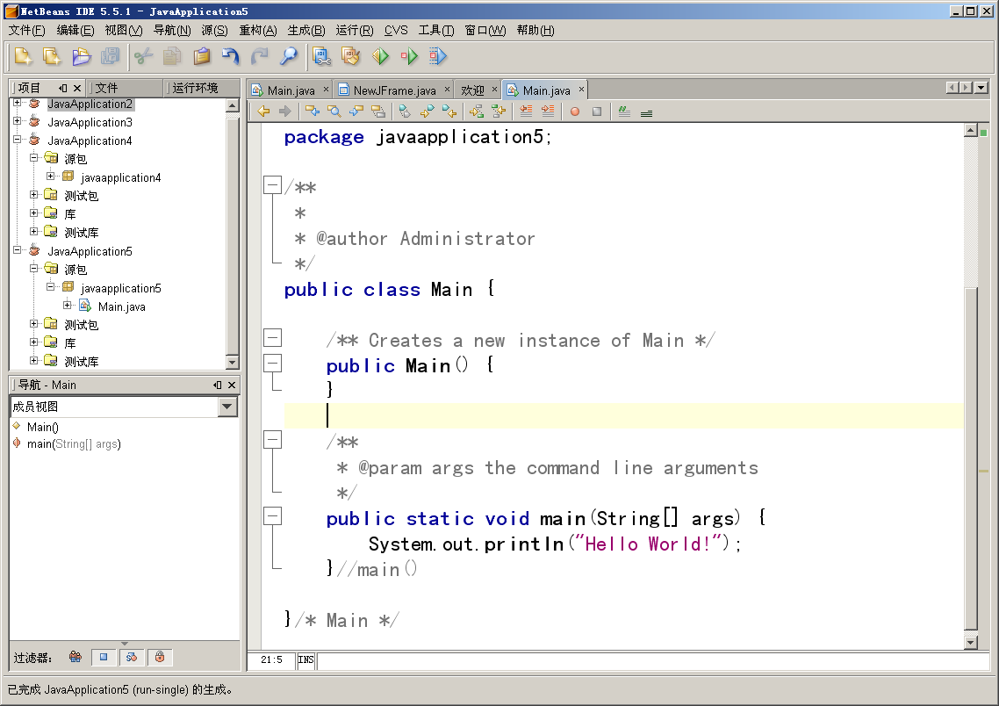
Use NetBeans to run HelloWorld

Slide 83
Brief summary
Write the first Java program
Run the first Java program
Get the usage of JDK

Slide 84
Java vs. other languages

Slide 85
Java vs. C++
Just class
Multiple inheritance
Pointer
goto
Thread
Interface
char - unicode
/** - program documentation

Slide 86
Java vs. C#
C# is temporarily not a cross-platform solution
C# bears unmistakable similarities to Java

Slide 87
Summary

Slide 88
Java’s past, present and future
Developed by SUN
Created by James Gosling
“Write once, run anywhere”

Slide 89
What is Java
An graceful O-O language
Small, simple and portable

Slide 90
Java’s features
Dynamic, Multithread, High performance, Interpreted, Portable, Architecture-neutral, Secure, Robust, Distributed, O-O, Simple

Slide 91
The program types of Java
Application
Applet
JavaBeans
Enterprise JavaBeans

Slide 92
Development tools
JBuilder
Visual Age for Java
JDeveloper
IntelliJ
Eclipse
Netbeans
Jcreator
Notepad, textpad

Slide 93
The first Java program
Hello World

Slide 94
Java vs. other languages
Java vs. C#
Java vs. C++

Slide 95
Exercise
Write HelloWorld program
Run in JDK
Run in Eclipse/Netbeans

Slide 96
Thanks!
http://10.10.10.95
hpnkanimba@iprcsouth.ac.rw

